Slide 1
API and Web Services

Slide 2
web service (WS)
a service offered by an electronic device to another electronic device, communicating with each other via the Internet, or
a server running on a computer device, listening for requests at a particular port over a network, serving web documents (HTML, JSON, XML, images).

Slide 3
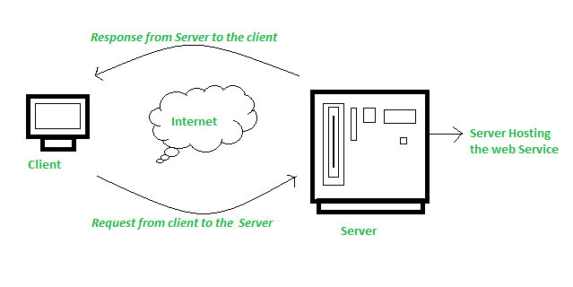
web service (WS)

Slide 4
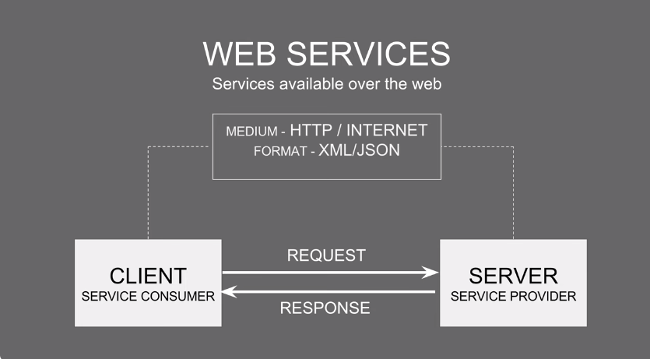
web service (WS)

Slide 5
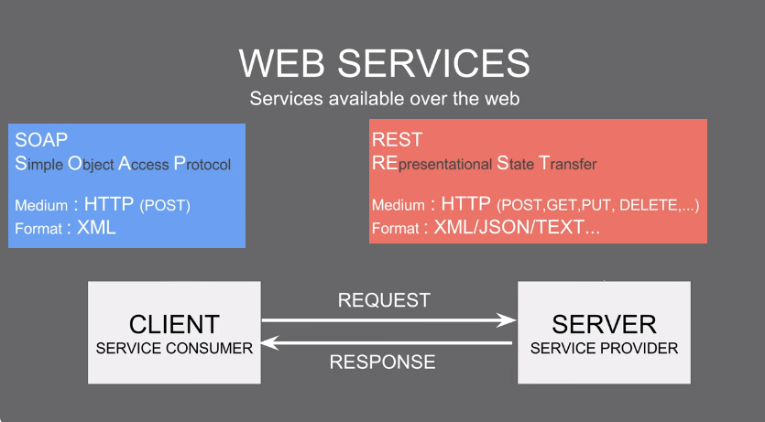
Types of web services

Slide 6
Types of web services
Extensible Markup Language. XML is used to tag, code and decode data. XML-remote procedure call, or XML-RPC, is a basic XML protocol using HTTP to exchange data and communicate between client and server systems.
Simple Object Access Protocol. SOAP is an XML-based web service protocol used to transfer data using SOAP messages. The SOAP protocol was developed to enable different programming languages to communicate quickly and with minimal effort using HTTP or Simple Mail Transfer Protocol (SMTP).

Slide 7
Web Services Description Language. WSDL is used to tell the client application what's included in the web service and how to connect. Variations on WSDL include Web Services Conversation Language and Web Services Flow Language.
Representational State Transfer. Based on HTTP, REST provides interoperability between devices and the internet for application programming interface (API)-based tasks. While not all RESTful web services use the REST protocol, applications built with RESTful APIs are more lightweight, manageable and scalable.

Slide 8
Universal Description, Discovery and Integration. UDDI is an XML-based standard that lists and details what services are available in an application. It makes web services discoverable to other services and facilitates digital transactions and e-commerce.

Slide 9
WSDL
Service Provider publishes an interface for his web services that describes all attributes of the web services.
This is XML based interface and is called Web Services Description Language WSDL.
Describes the functionalities of the web services.

Slide 10
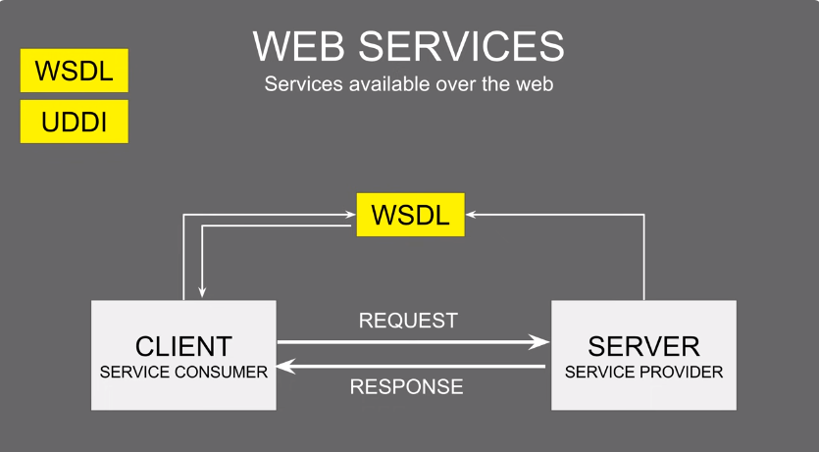
WSDL

Slide 11
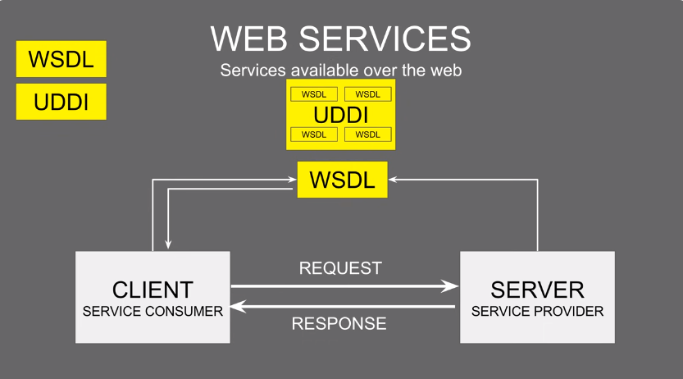
UDDI

Slide 12
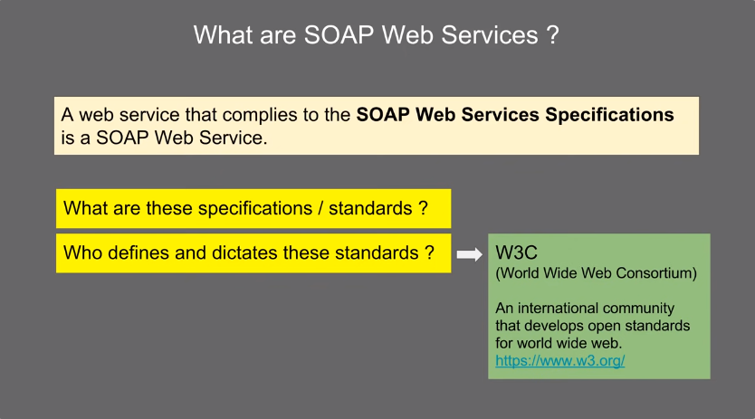

Slide 13
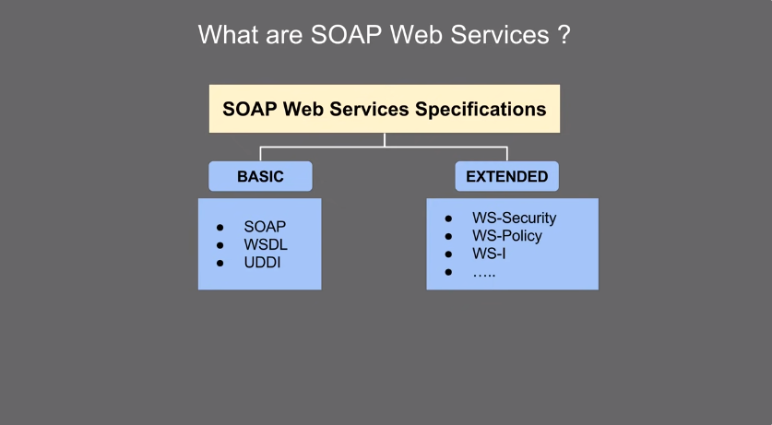

Slide 14
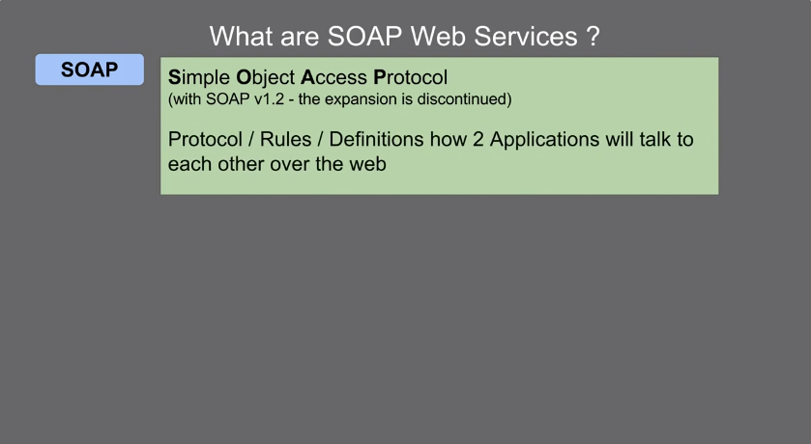

Slide 15
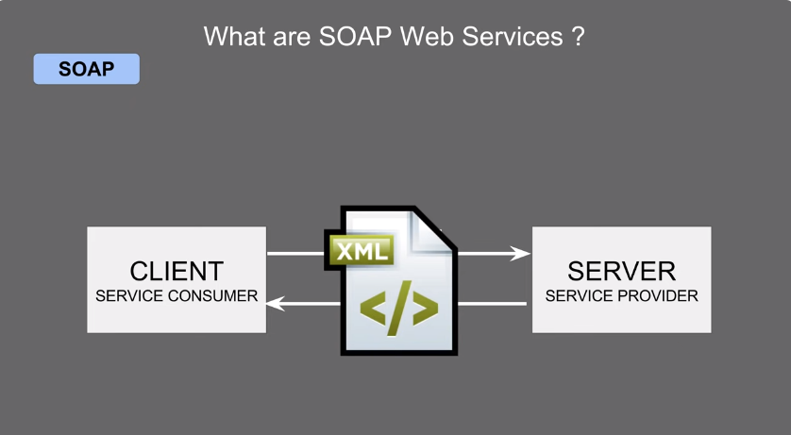

Slide 16
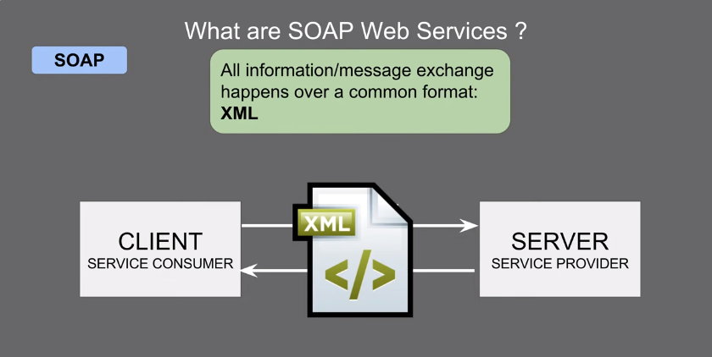

Slide 17
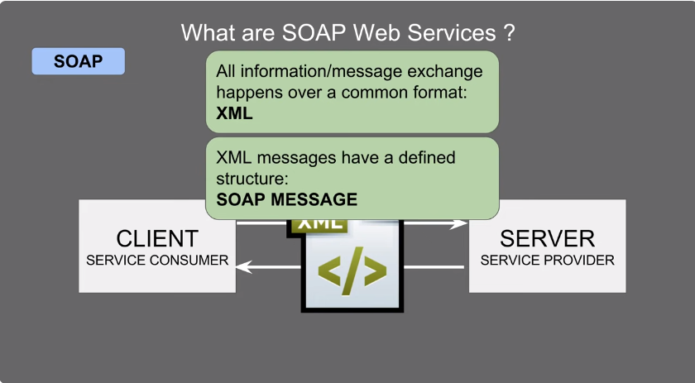

Slide 18
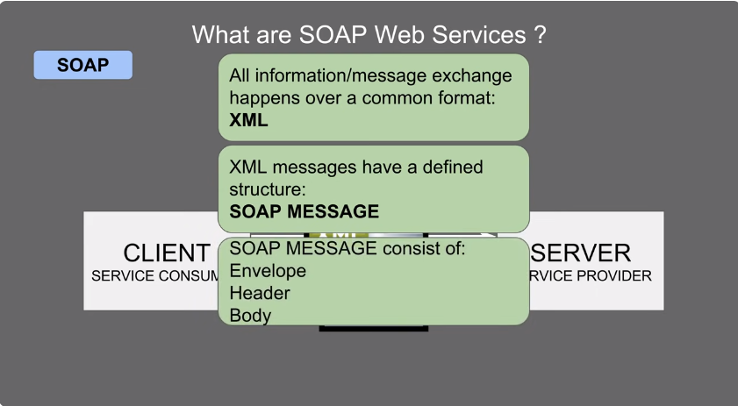

Slide 19
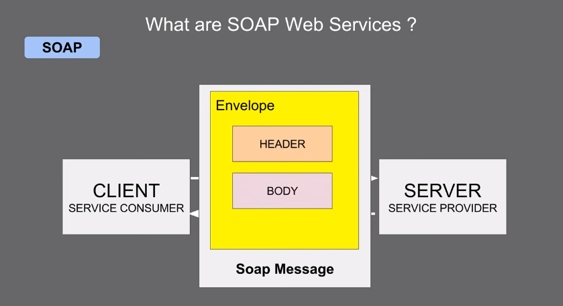

Slide 20
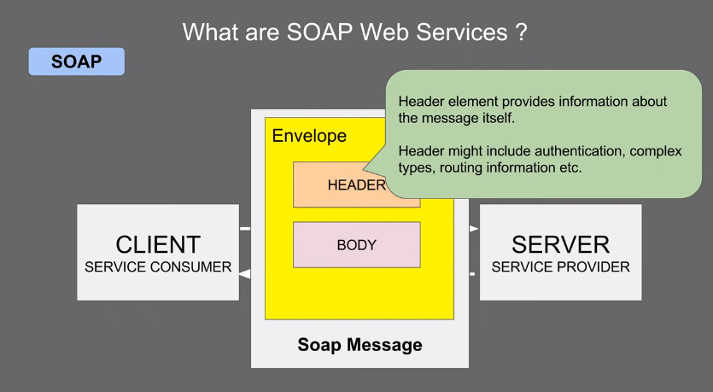

Slide 21
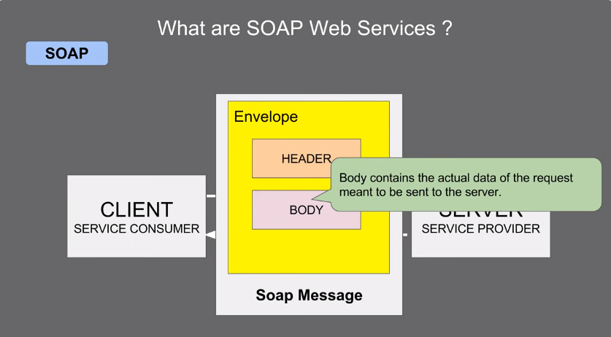

Slide 22
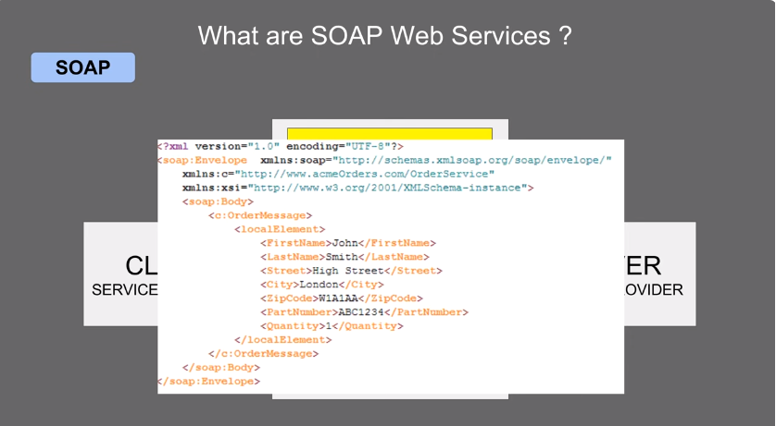

Slide 23
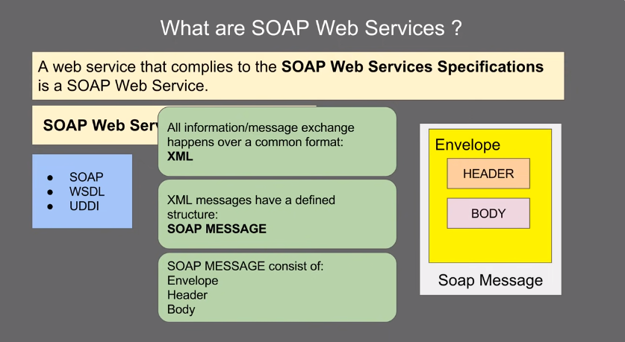

Slide 24
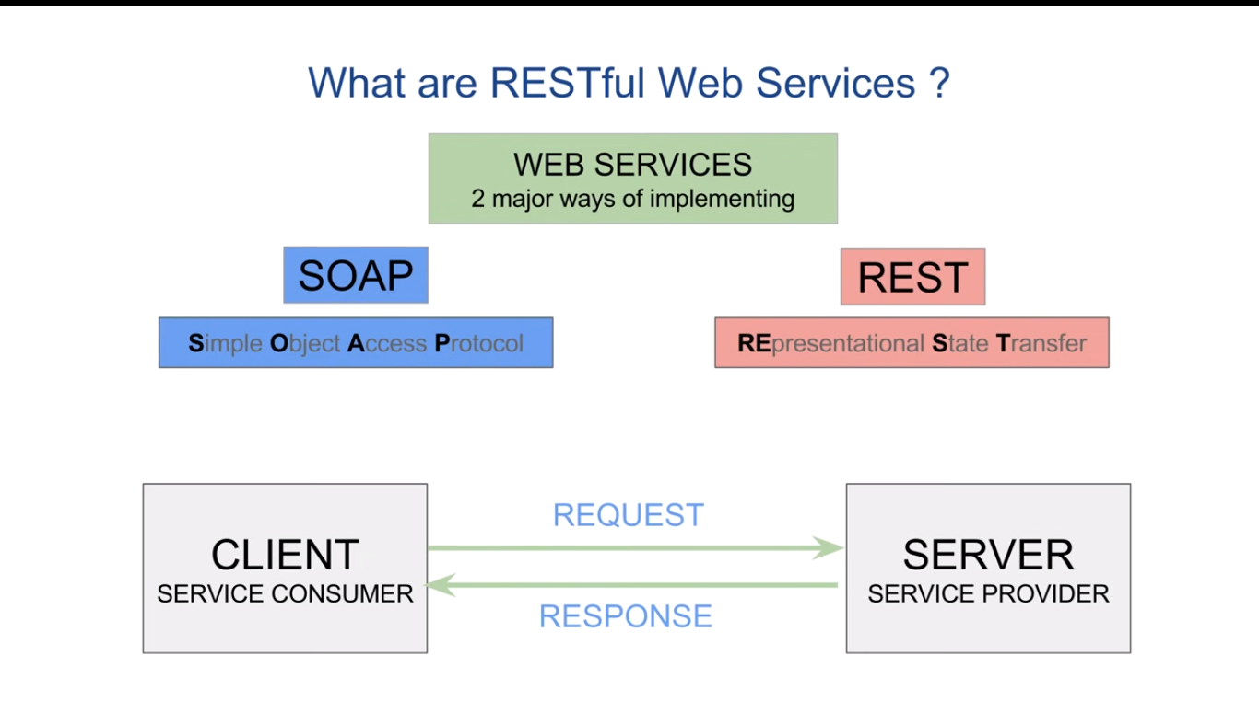

Slide 25
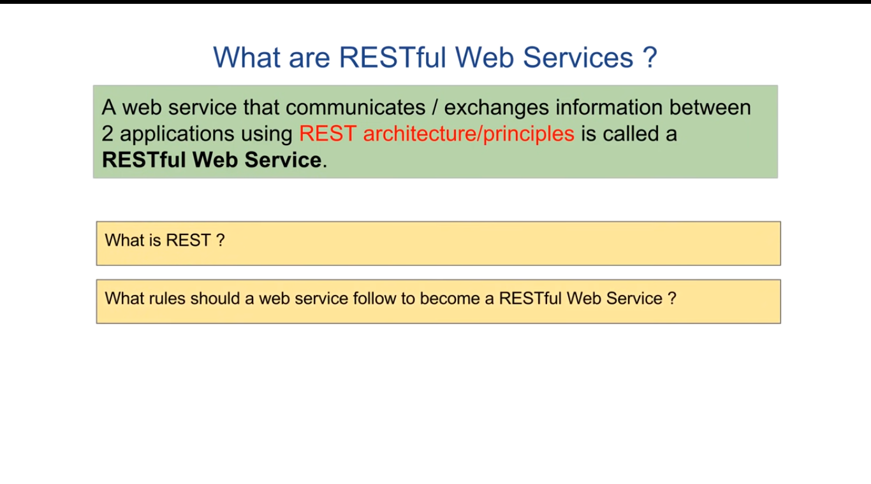

Slide 26
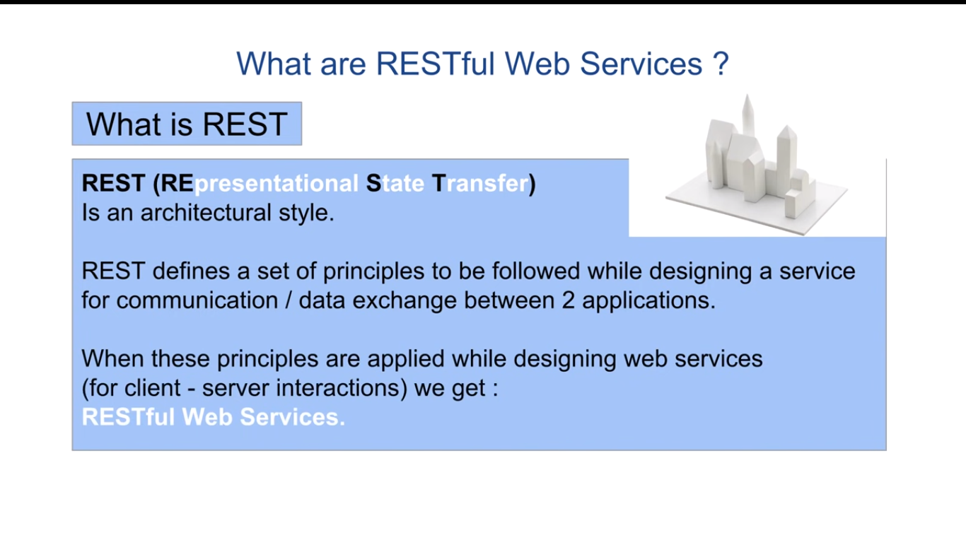

Slide 27
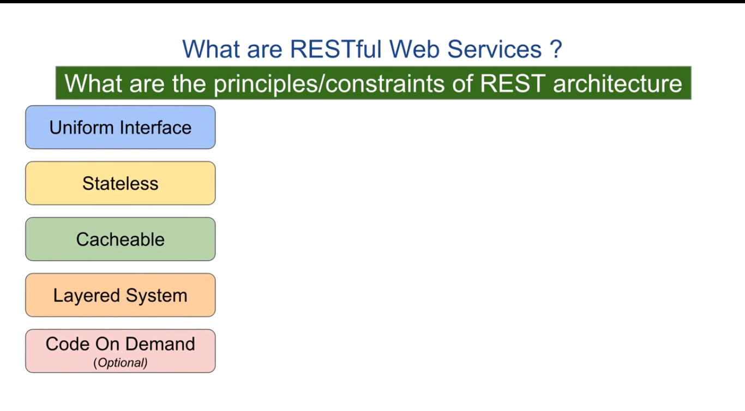

Slide 28
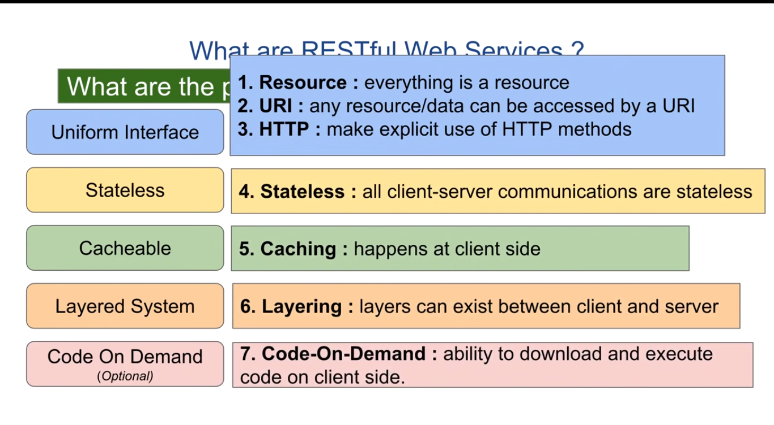

Slide 29
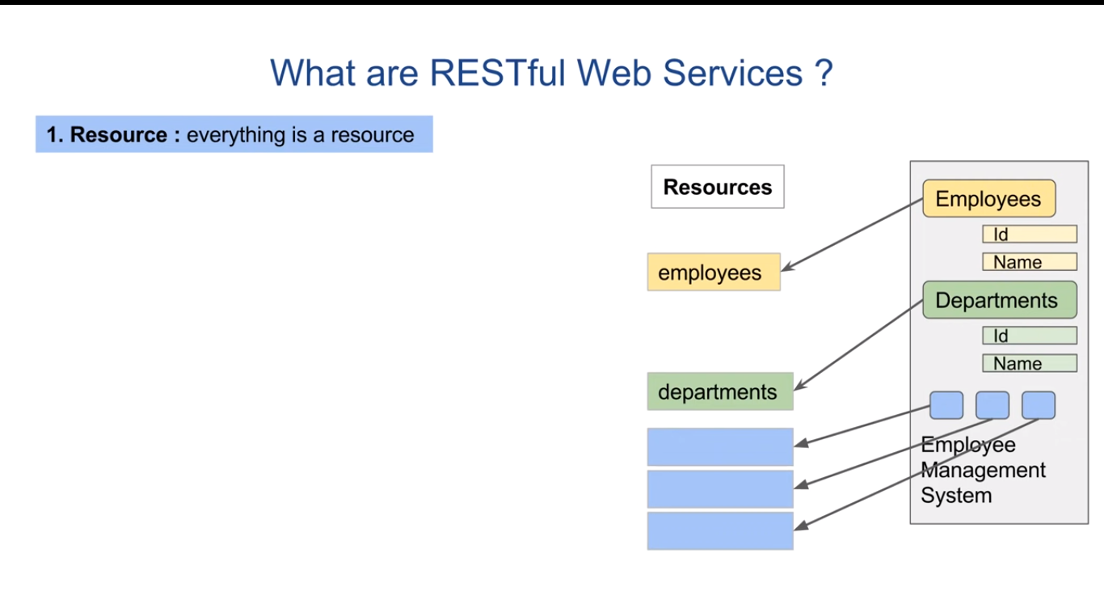

Slide 30
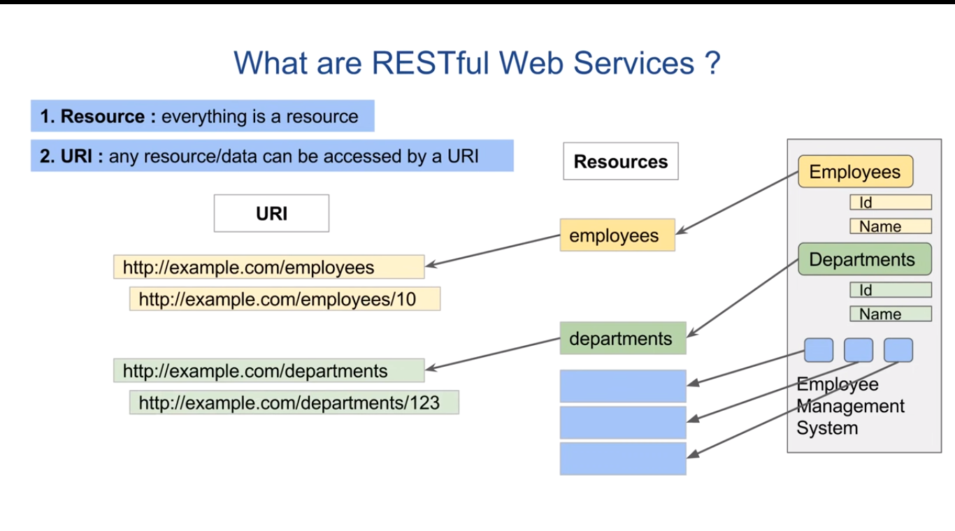

Slide 31
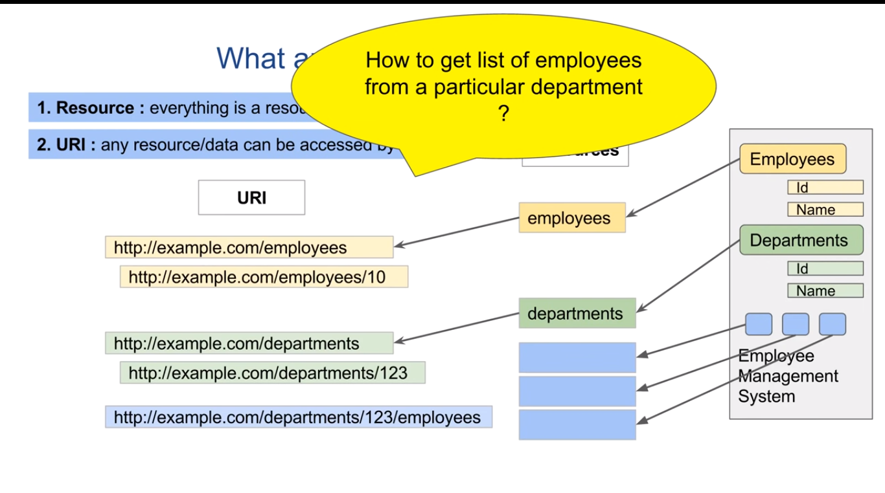

Slide 32
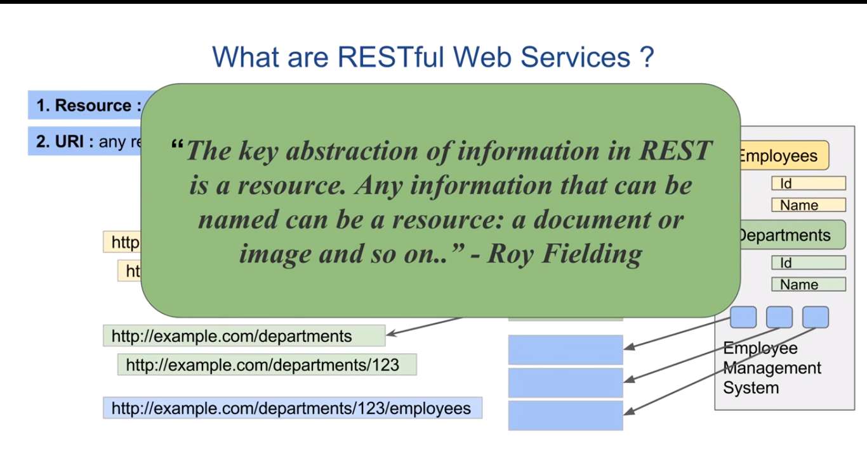

Slide 33
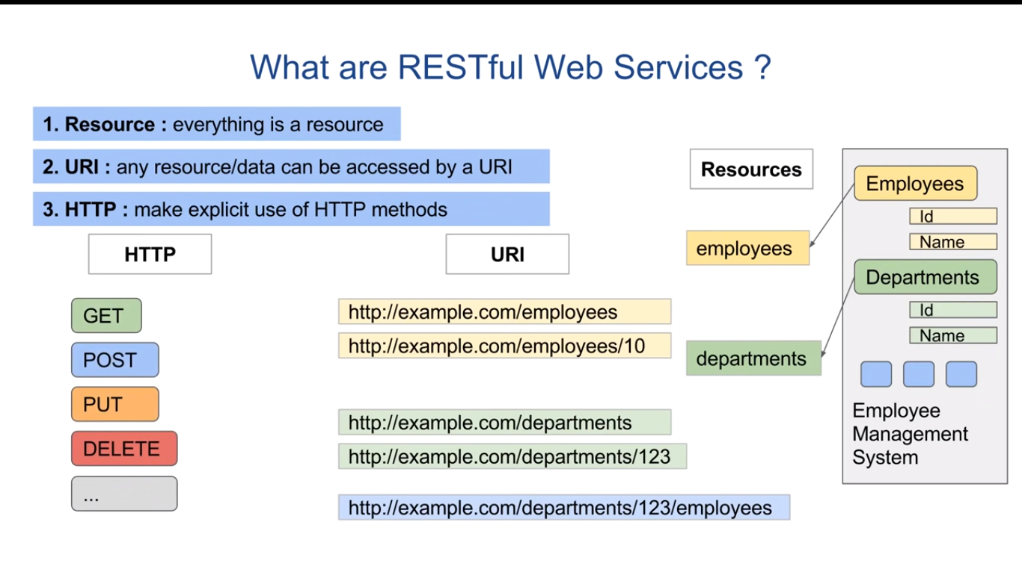

Slide 34
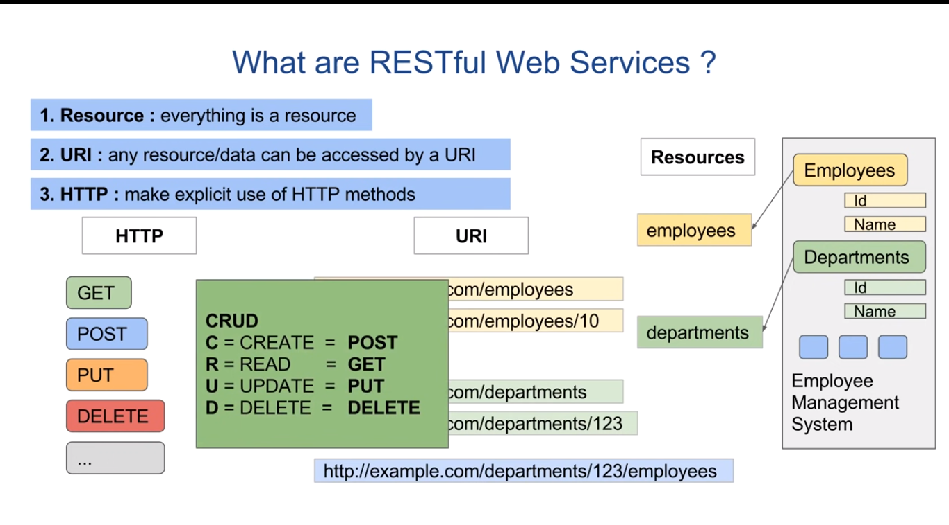

Slide 35
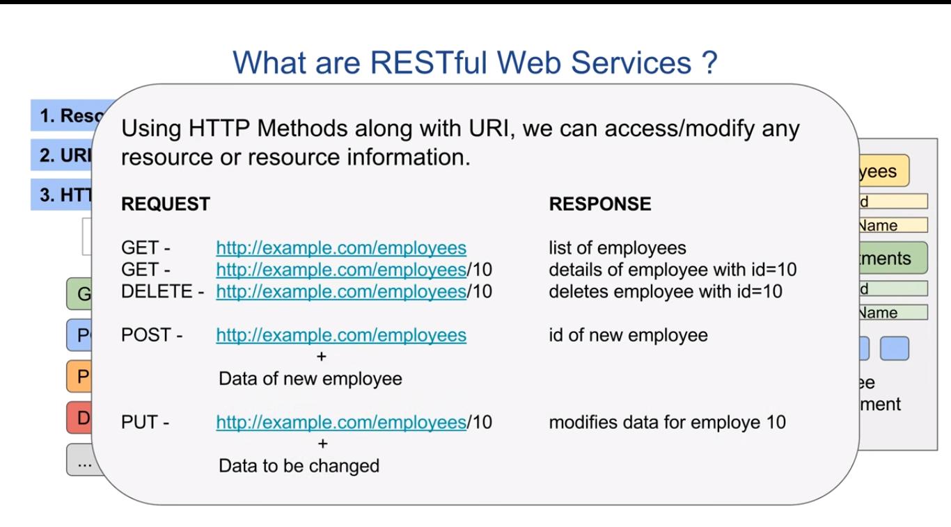

Slide 36
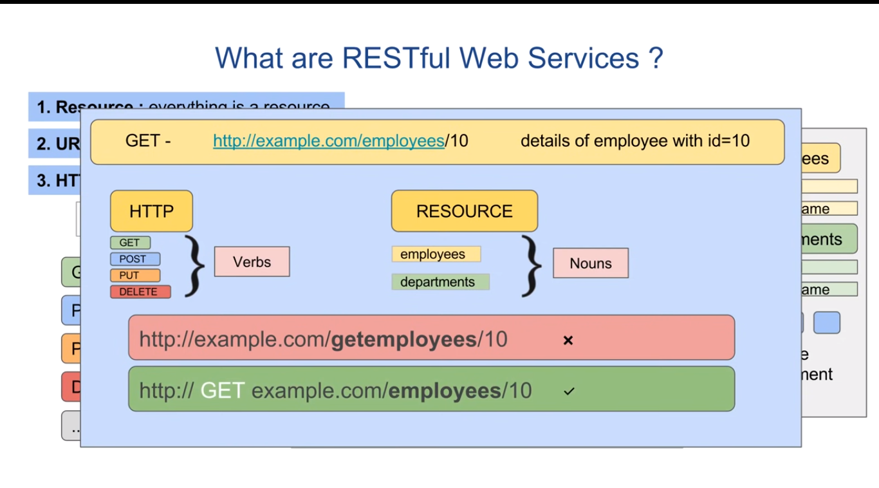

Slide 37
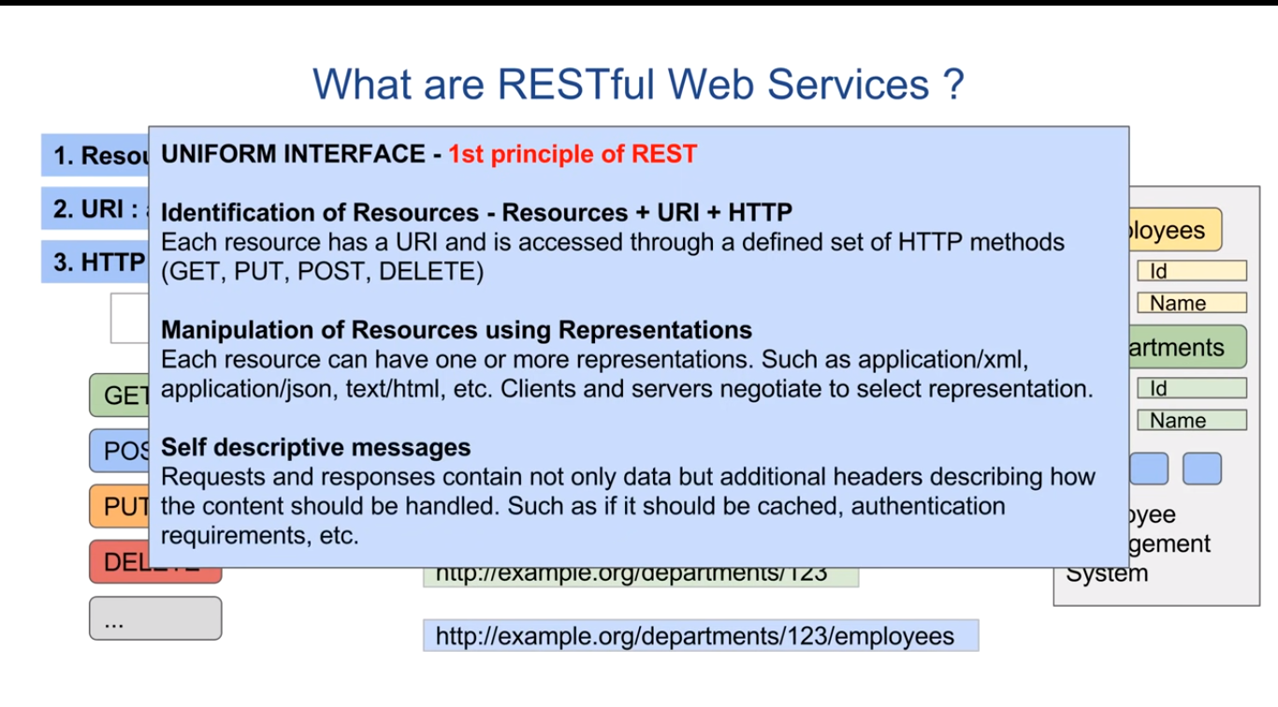

Slide 38
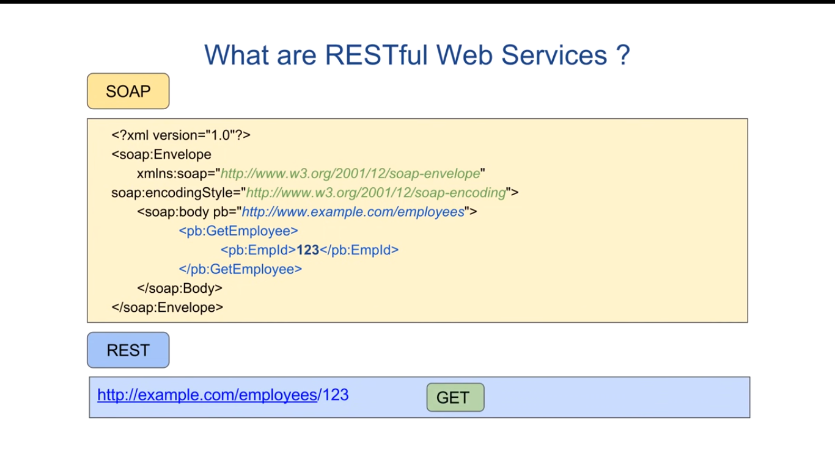

Slide 39
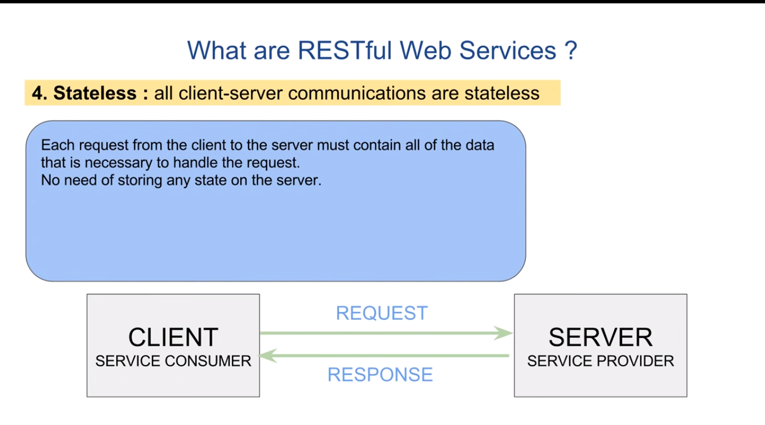

Slide 40
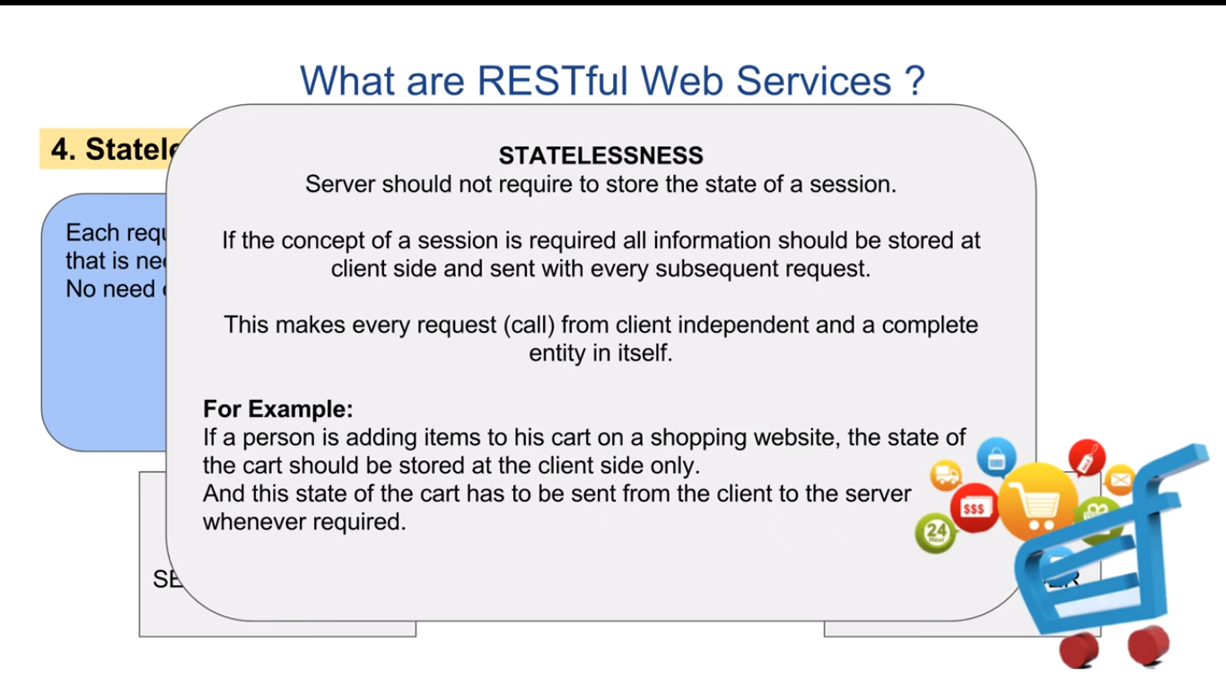

Slide 41
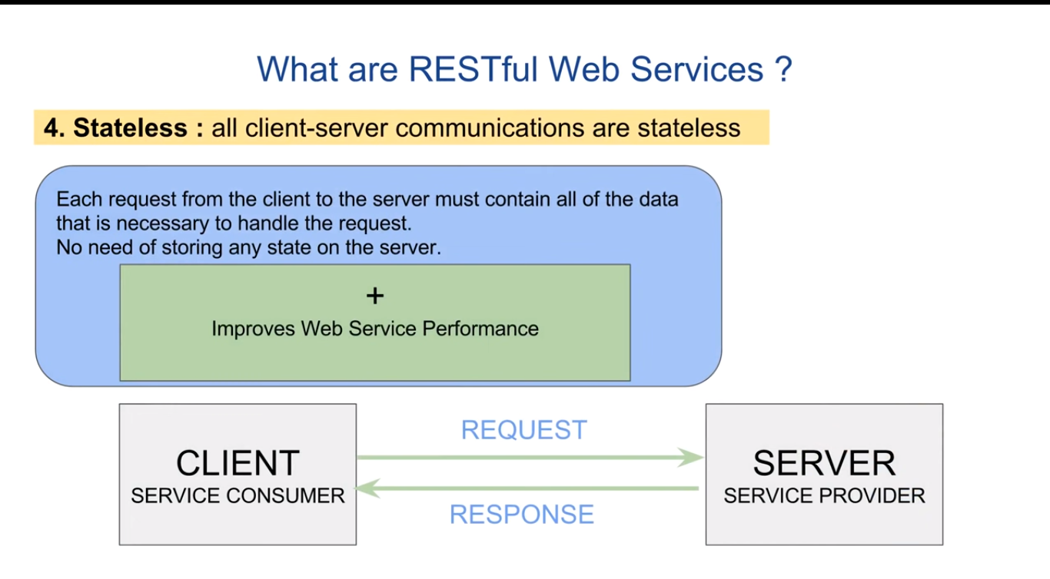

Slide 42
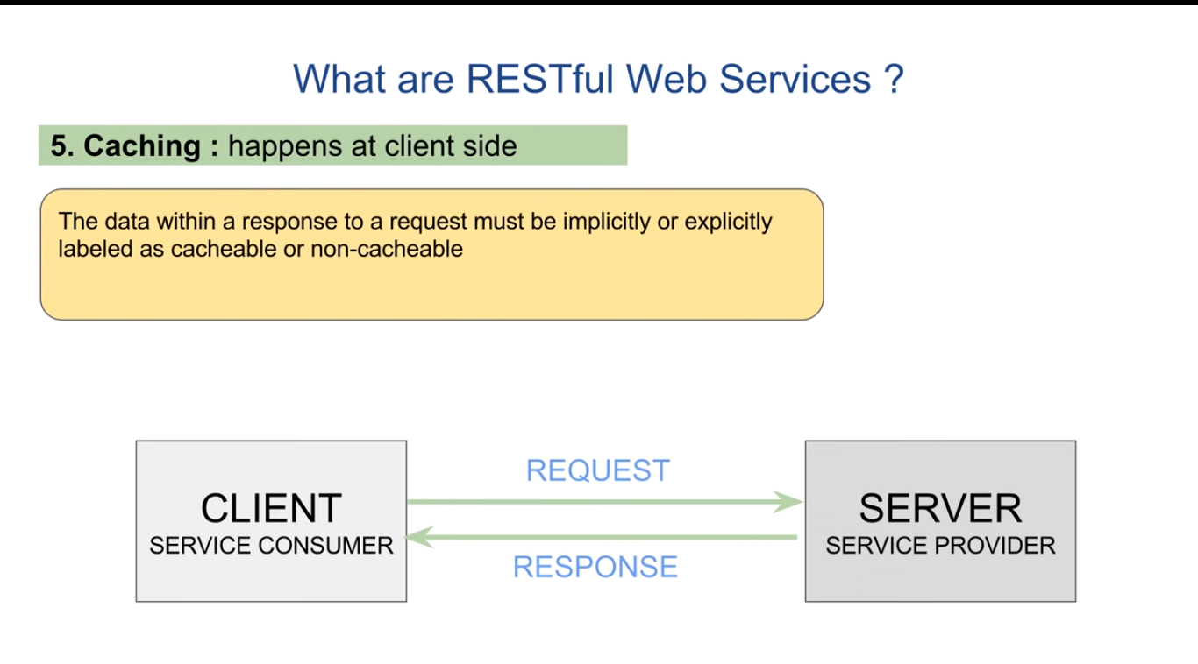

Slide 43
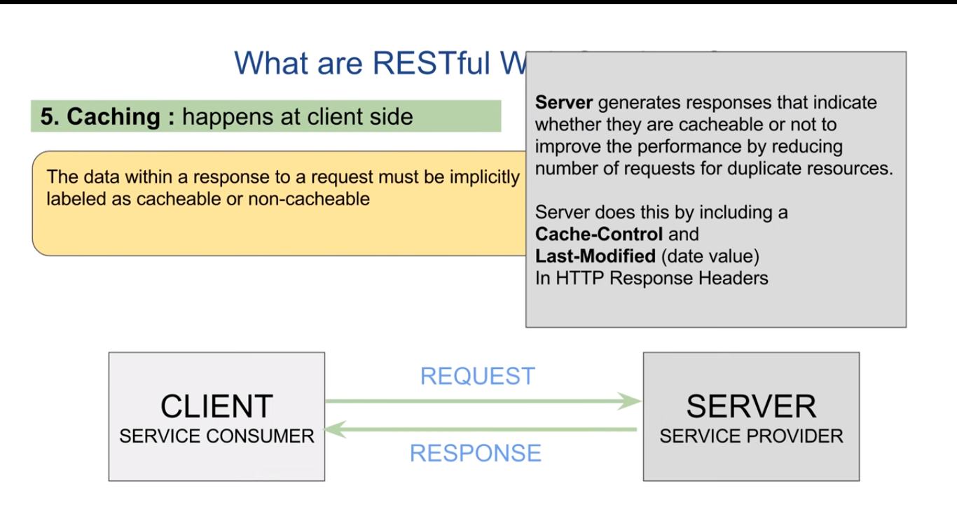

Slide 44
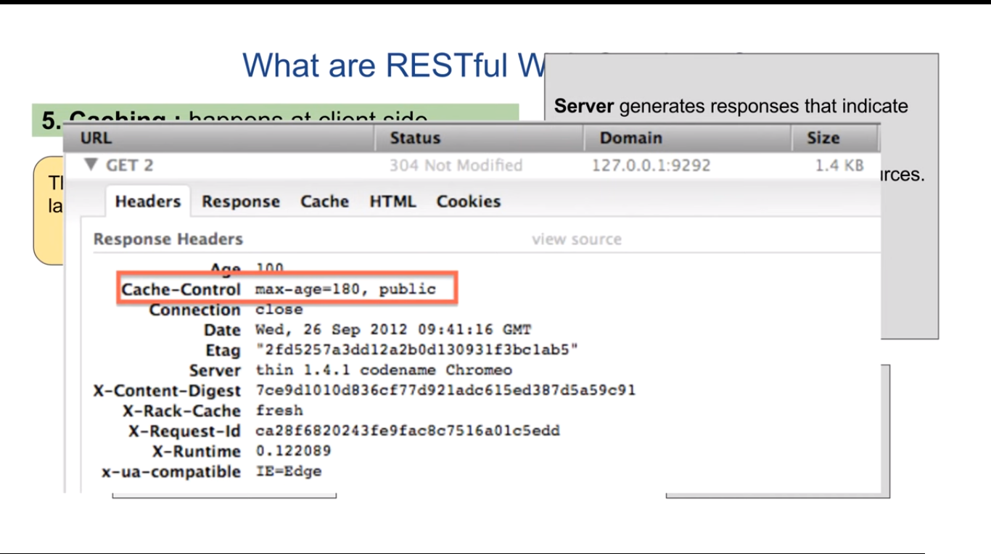

Slide 45
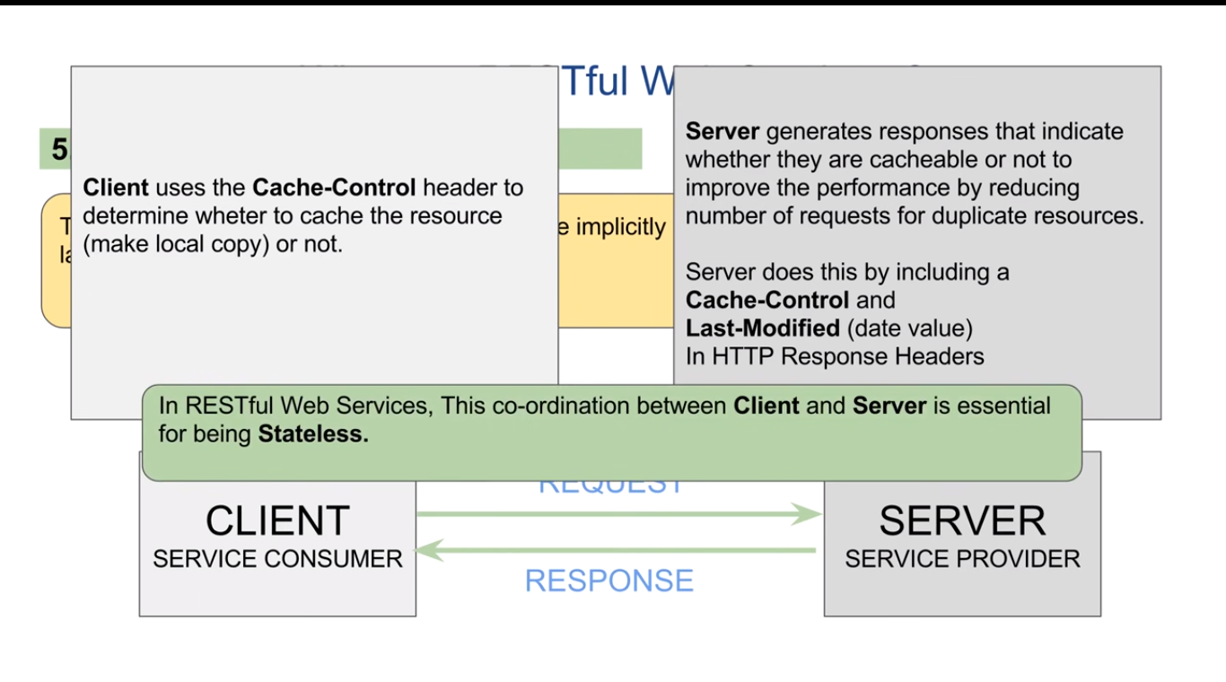

Slide 46
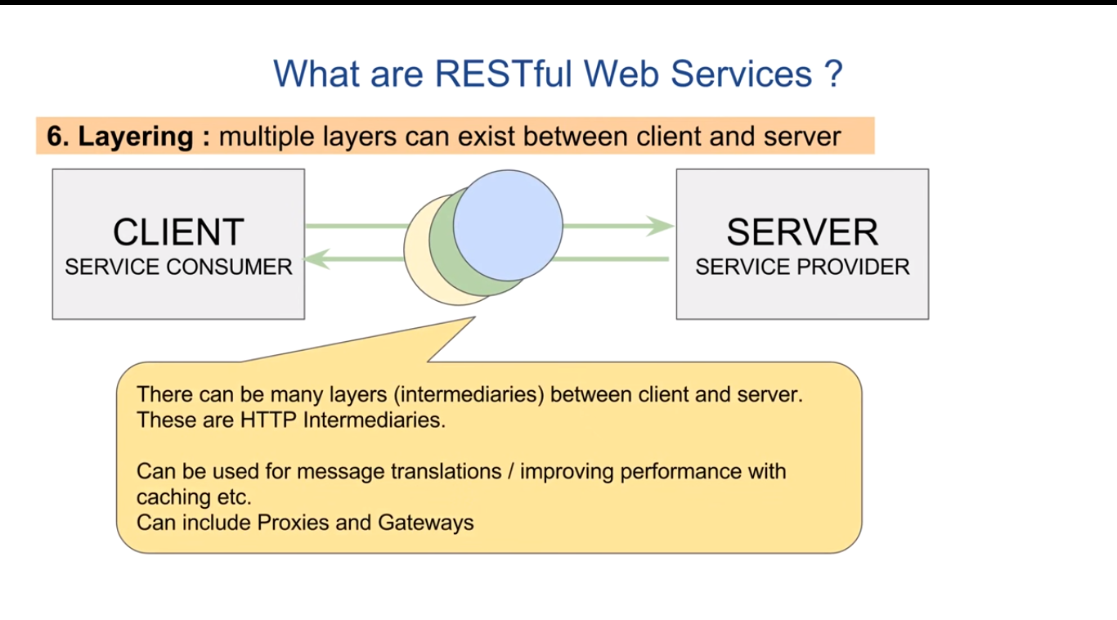

Slide 47
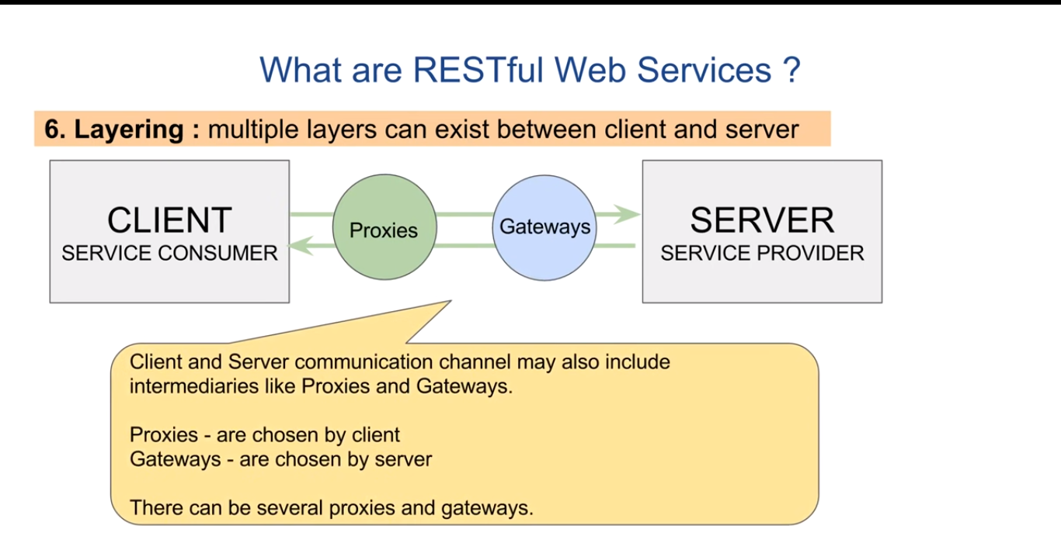

Slide 48
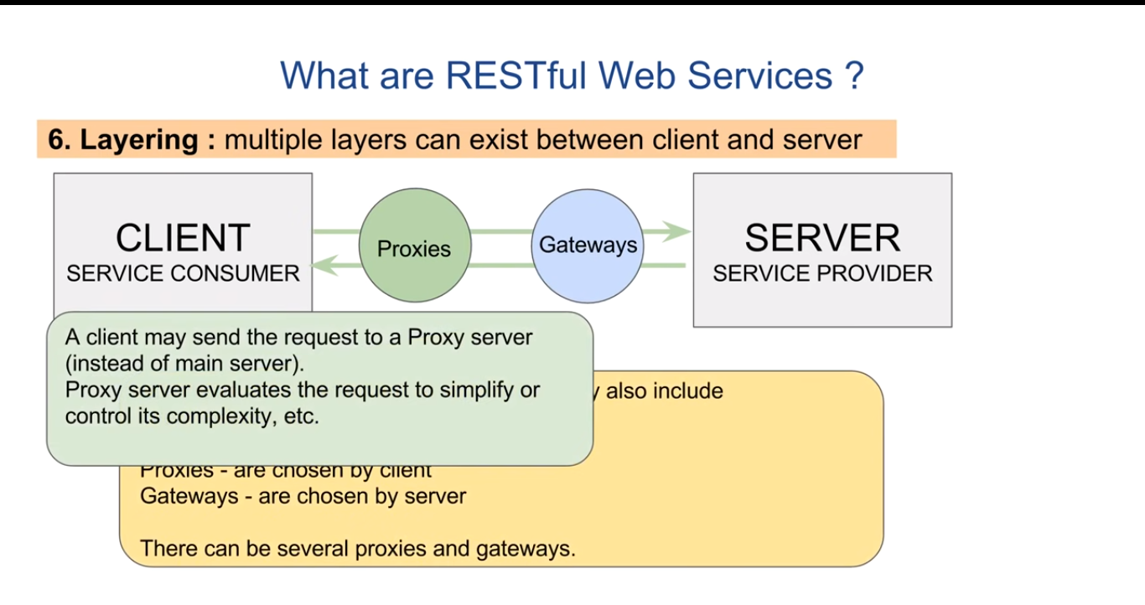

Slide 49
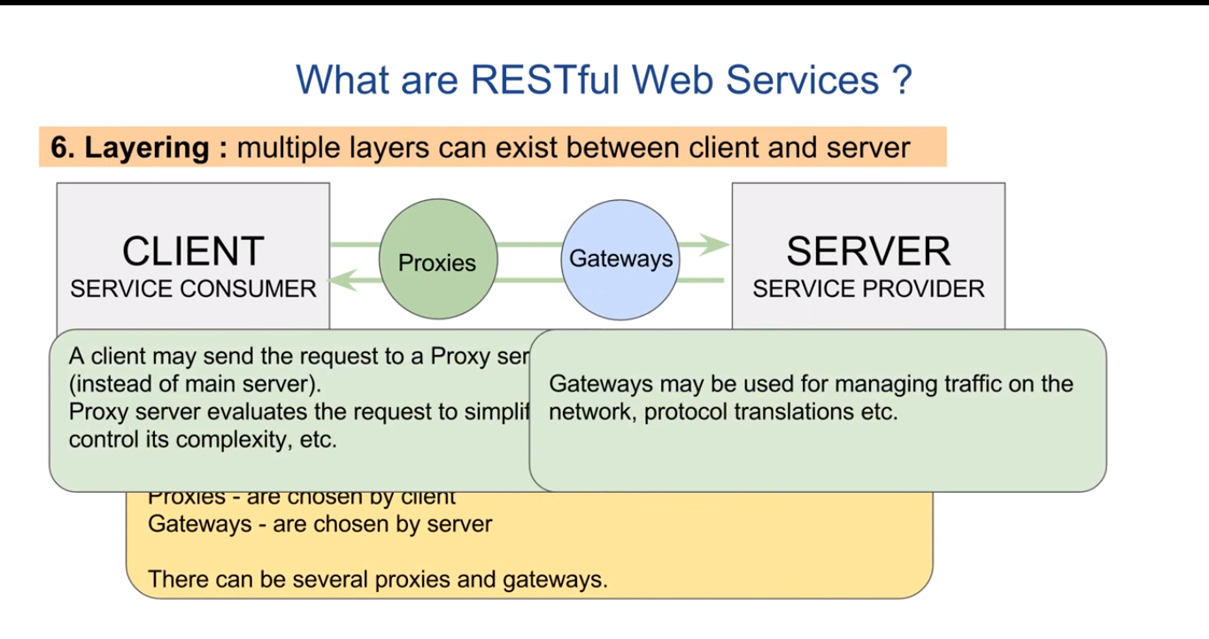

Slide 50
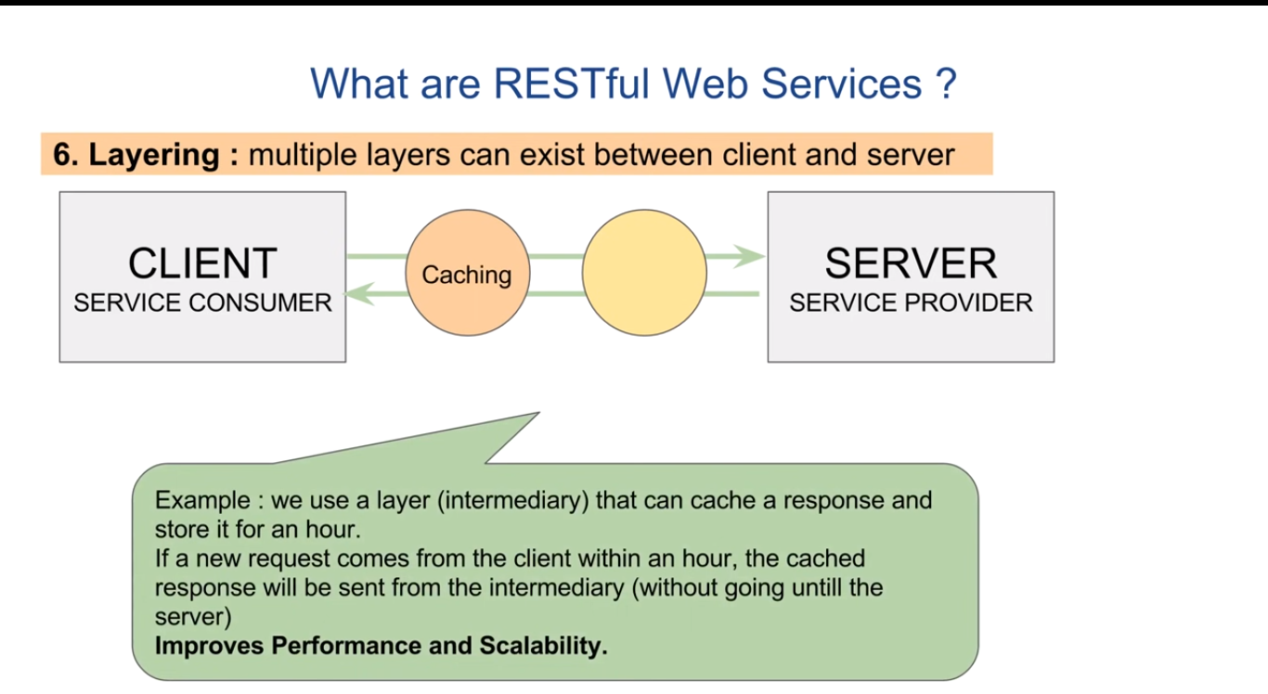

Slide 51
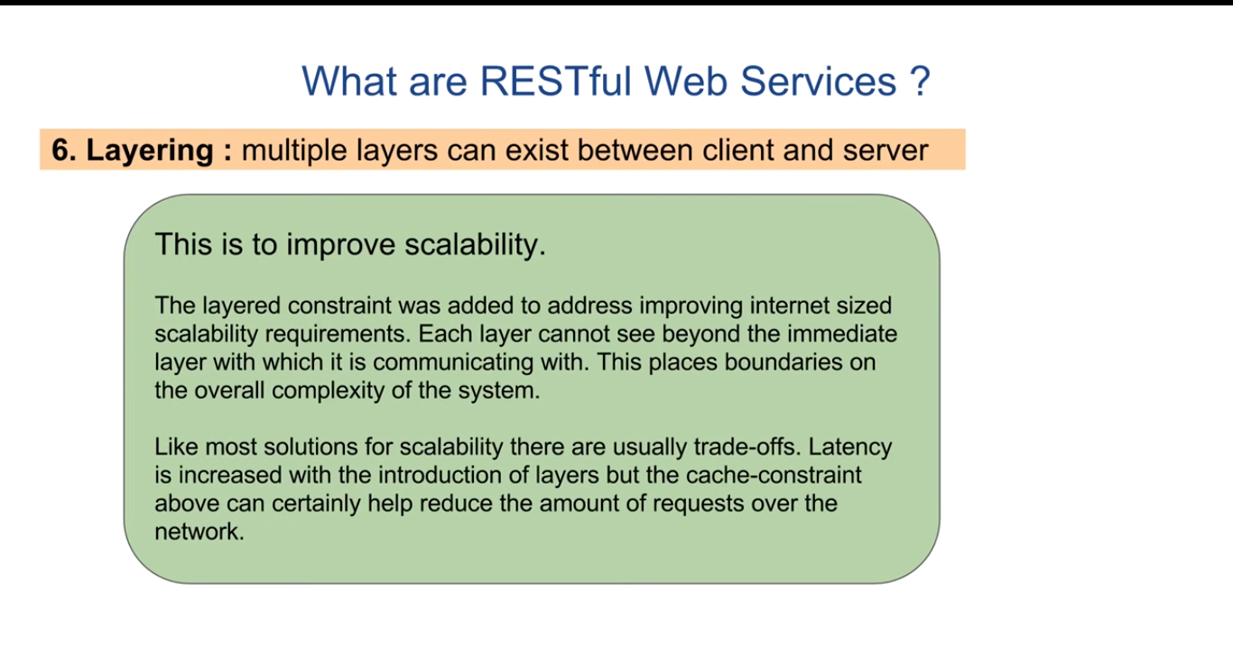

Slide 52
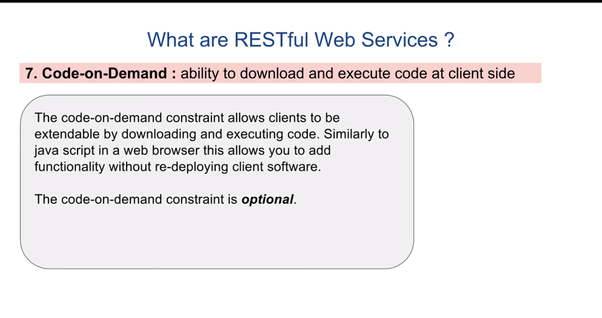

Slide 53
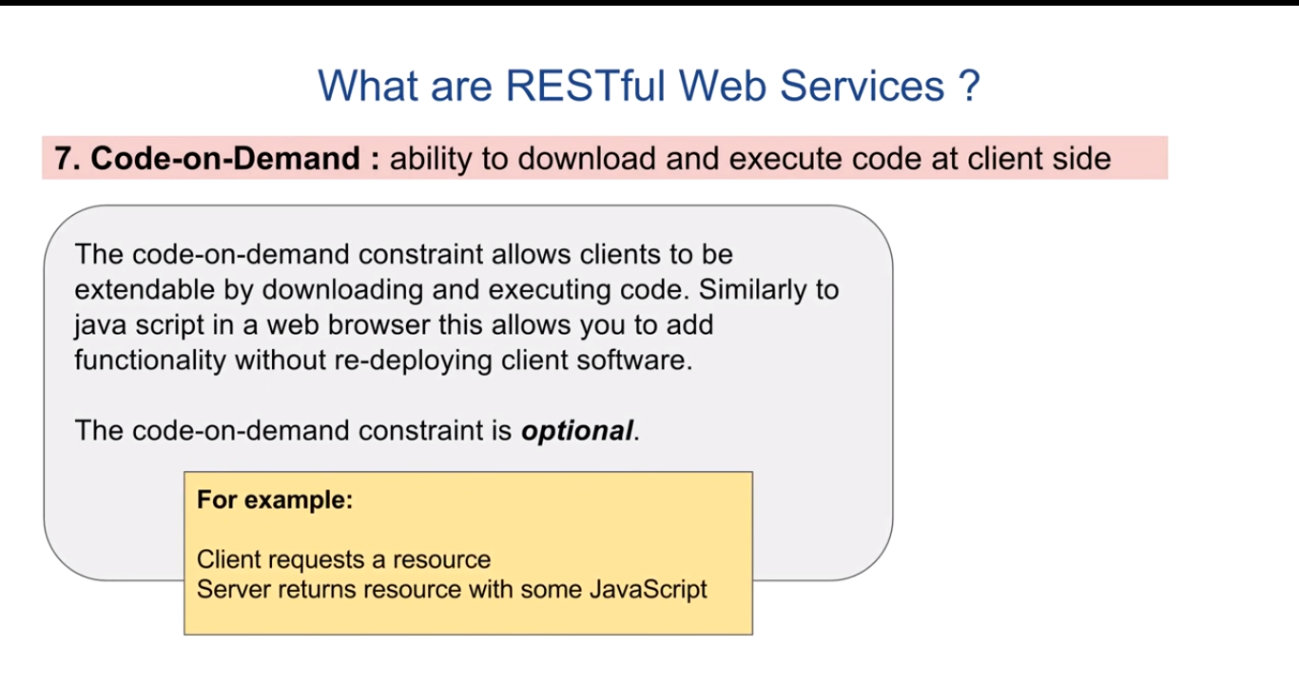

Slide 54
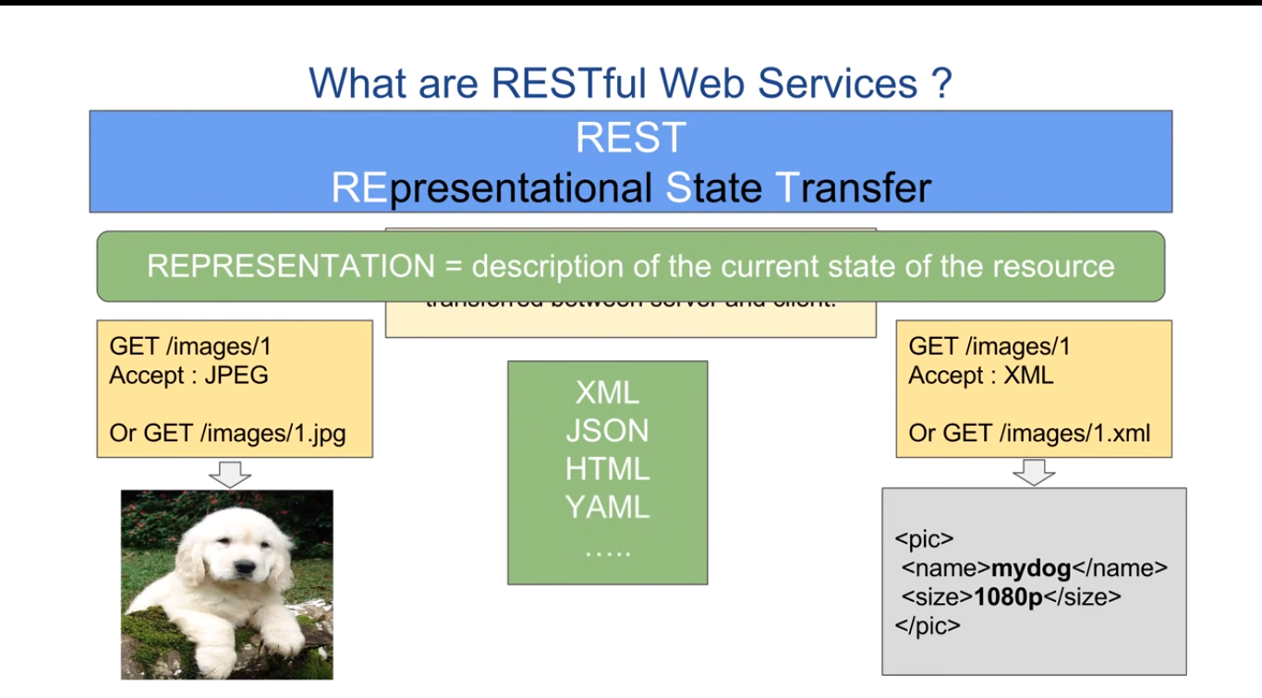

Slide 55
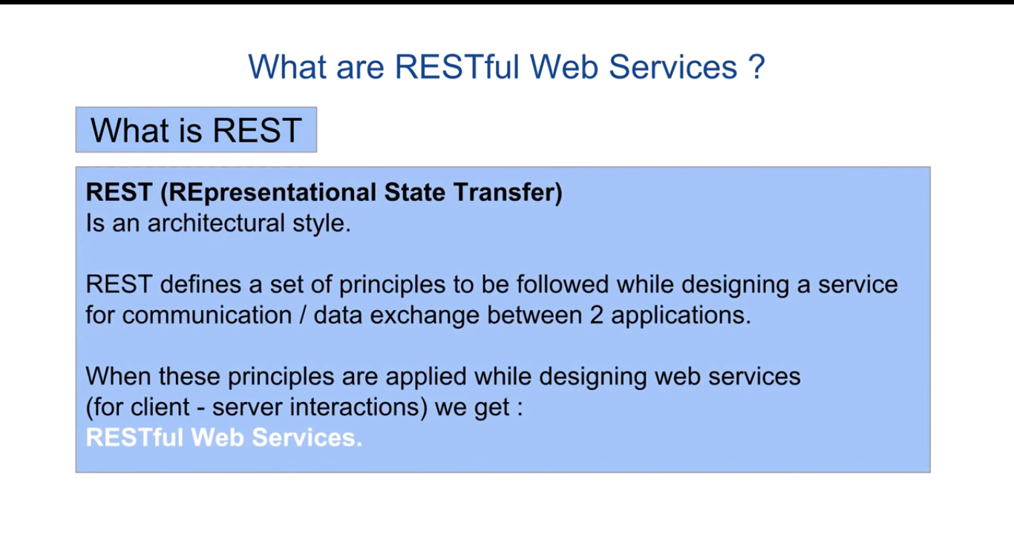

Slide 56
